Slide 1

Large Language Models and Their Application to Biomedical Domain: Introduction, Overview, and Future
Avisha Das, Ph.D.
University of Texas Health Science Center at Houston

Slide 2
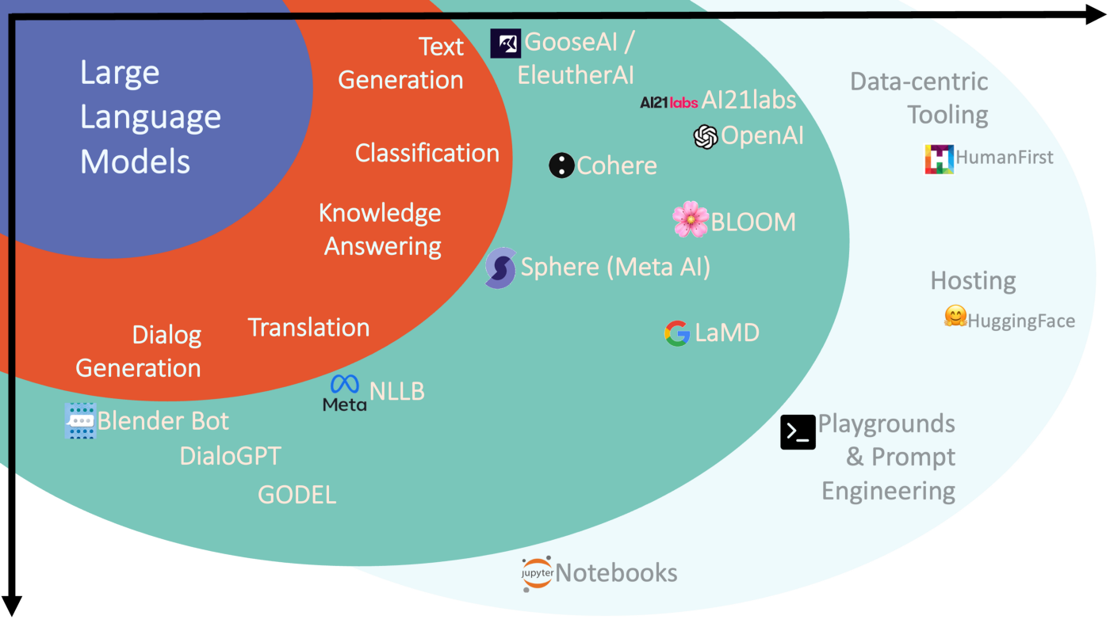
Large Language Models
Large Language Models or LLMs are deep learning algorithms that can recognize, summarize, translate, predict and generate text and other content based on knowledge gained from massive datasets.

Slide 3
Agenda
Language Modeling and Large Language Models
Model types and their variants
Deeper dive and dissecting LLMS
Architecture variants
Model scaling
Using and adapting LLMs
Biomedical and Clinical Domain
Evaluation
Risks of LLMs
Data, Privacy, and Bias

Slide 4
Agenda
Language Modeling and Large Language Models
Model types and their variants
Deeper dive and dissecting LLMS
Architecture variants
Model scaling
Risks
Using and adapting LLMs
Biomedical and Clinical Domain
Evaluation
Risks of LLMs
Data, Privacy, and Bias

Slide 5
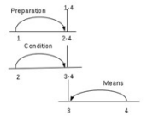
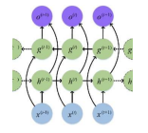

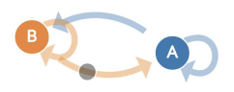
Evolution of Natural Language Processing Systems
Deep Learning
1966
1986
2013
1979
1991
2017
Template-based systems:
Use Rules and Templates
Rule-based + Data Driven pipelines :
Document planning + microplanning + realization
Modeling Discourse Structures :
Relation learning, Rhetorical Structure Theory
Statistical Methods : Sentence compression, reordering, lexical paraphrasing, syntactic transformation
DNNs (CNNs/RNNs): Autoregressive DNNs + Recurrent units, backpropagation
Transformers :
BERT, GPT (1/2/3),
ChatGPT

Slide 6


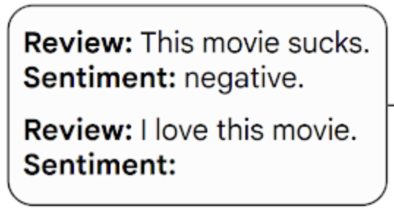
Language Modeling
Documents
Output
Positive
Language Model
Embeddings
Numeric Representation of Text
Useful for other downstream tasks
Language Model or LM is a probability distribution learned over a sequence of words.

Slide 7
Properties of Large Language Models
Large Language Models or LLMs are deep learning algorithms that can recognize, summarize, translate, predict and generate text and other content based on knowledge gained from massive datasets.
Usually tens of gigabytes in size with 100+ million trained parameters
BERT-Large model is ~300M parameters and GPT-3 has ~175B!
Have been pre-trained on enormous amounts of unlabeled text data, sometimes at the petabyte scale
GPT-Neo has been trained on 800GB Pile dataset
Achieve state-of-the-art results across a variety of Natural Language Understanding tasks
ChatGPT passed a Bar Practice Exam with 70%

Slide 8
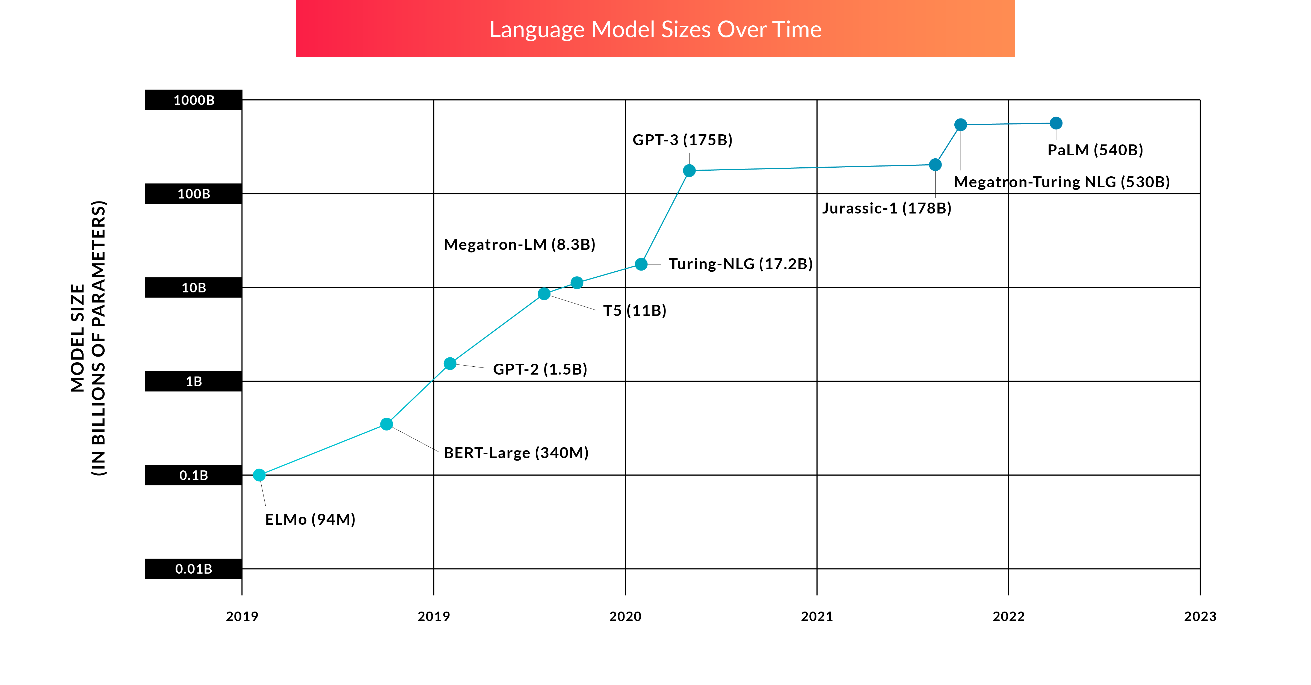
How “large” are Large Language Models?
Large Language Models over time
https://twosigmaventures.com/blog/article/the-promise-and-perils-of-large-language-models/

Slide 9
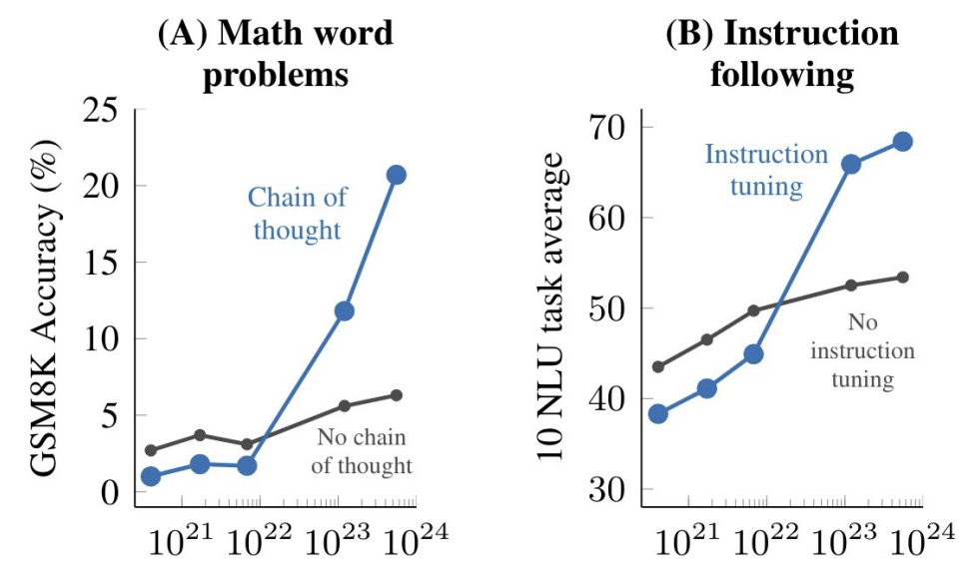
Why use LLMs?
The promise: one single model to solve many NLP tasks
Emergent properties in LLMs
Language Model
Output

Slide 10
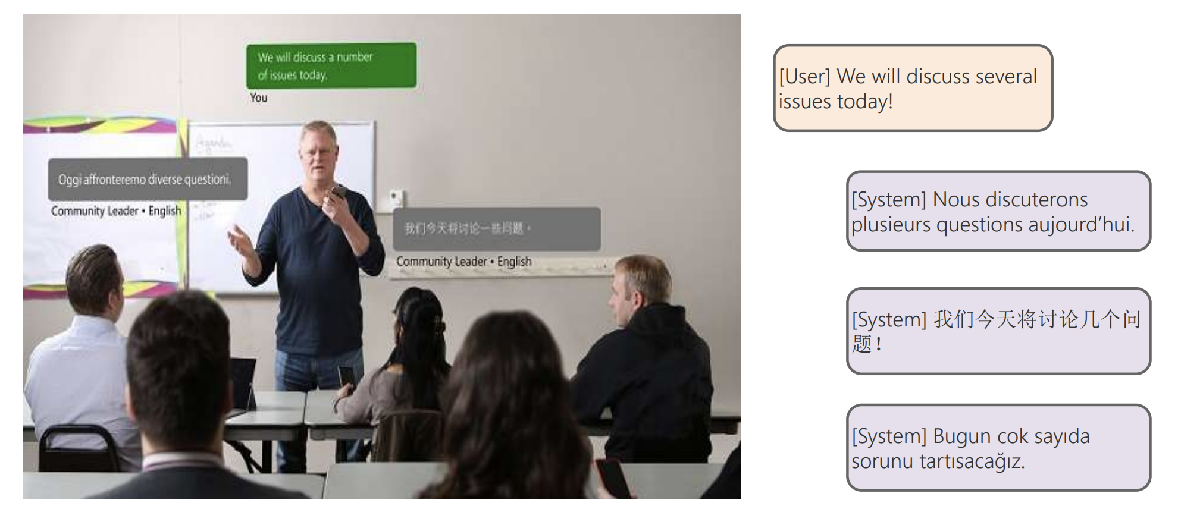
Not just bigger… Task Variety
Machine Translation

Slide 11
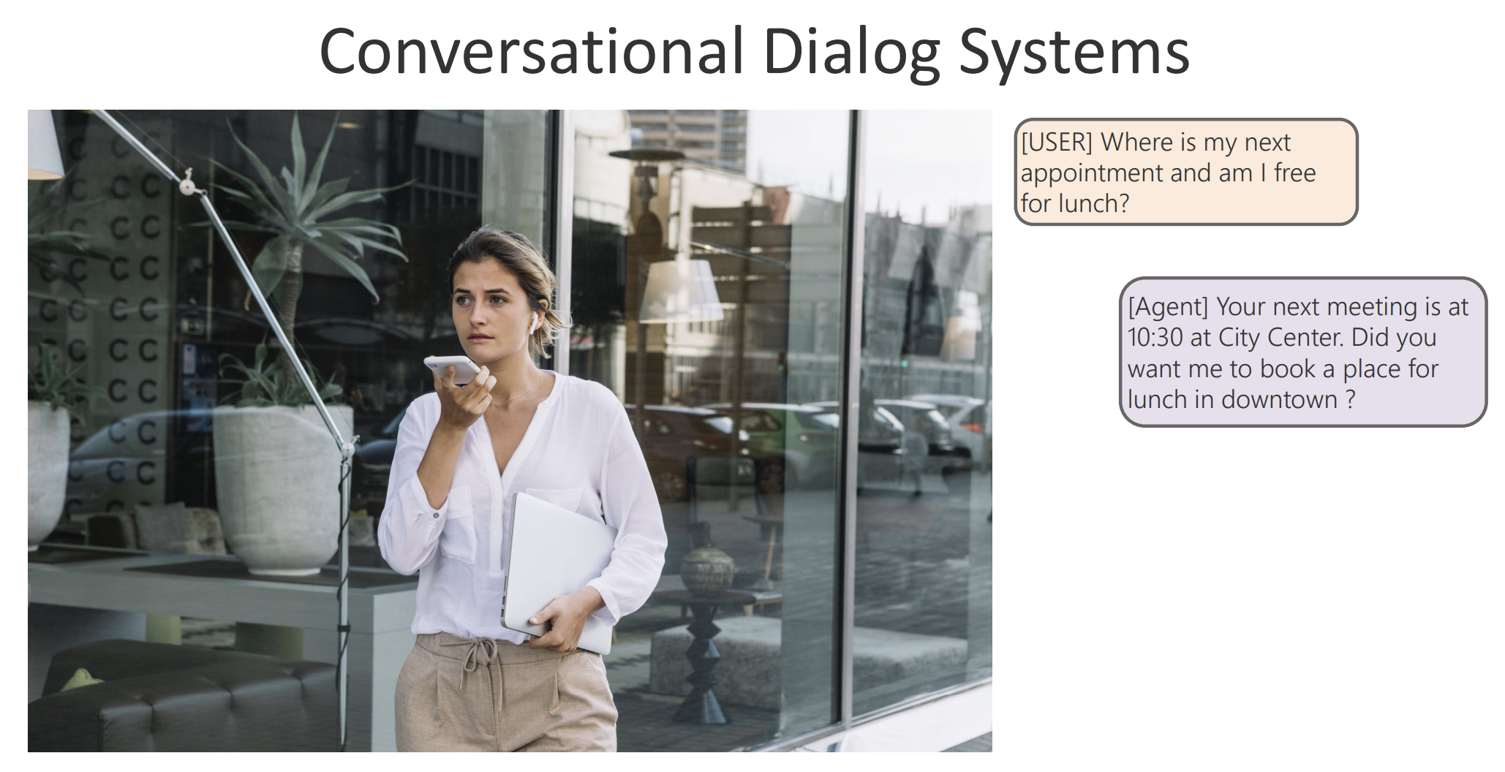
Not just bigger… Task Variety
Conversational Dialogs

Slide 12
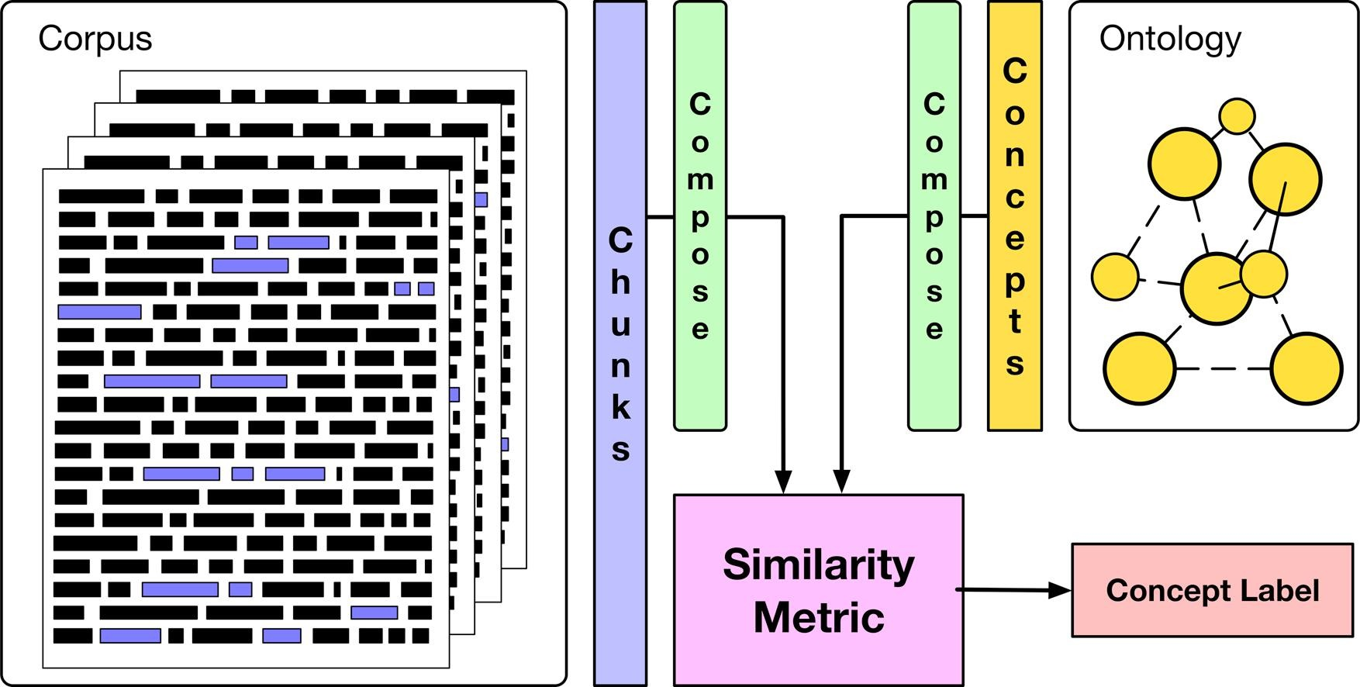
Not just bigger… Task Variety
Concept Extraction and Classification

Slide 13
Agenda
Language Modeling and Large Language Models
Model types and their variants
Encoder-only models
Deeper dive and dissecting LLMS
Architecture variants
Model scaling
Risks
Using and adapting LLMs
Biomedical and Clinical Domain
Evaluation
Risks of LLMs
Data, Privacy, and Bias

Slide 14
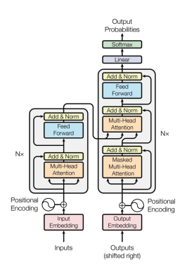
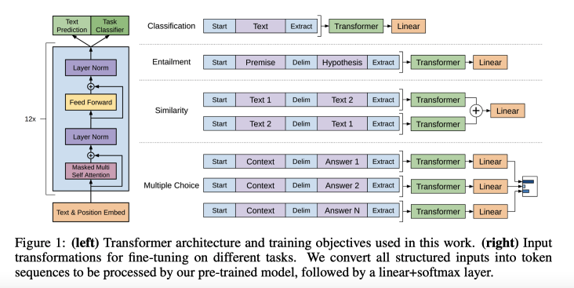
Prior Work
Prior Work:
Self-Attention Mechanism - Transformer (Circa 2017)

Slide 15
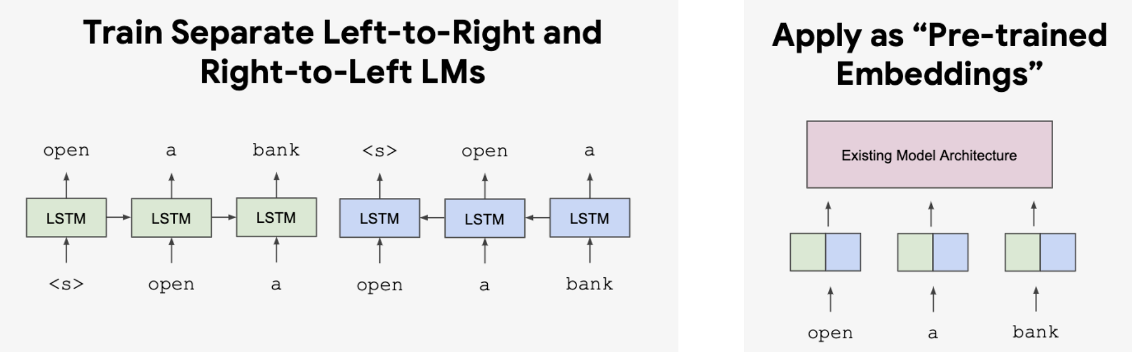
Prior Work
Prior Work:
LSTM-based model - ELMo (Circa 2017, 2018)

Slide 16
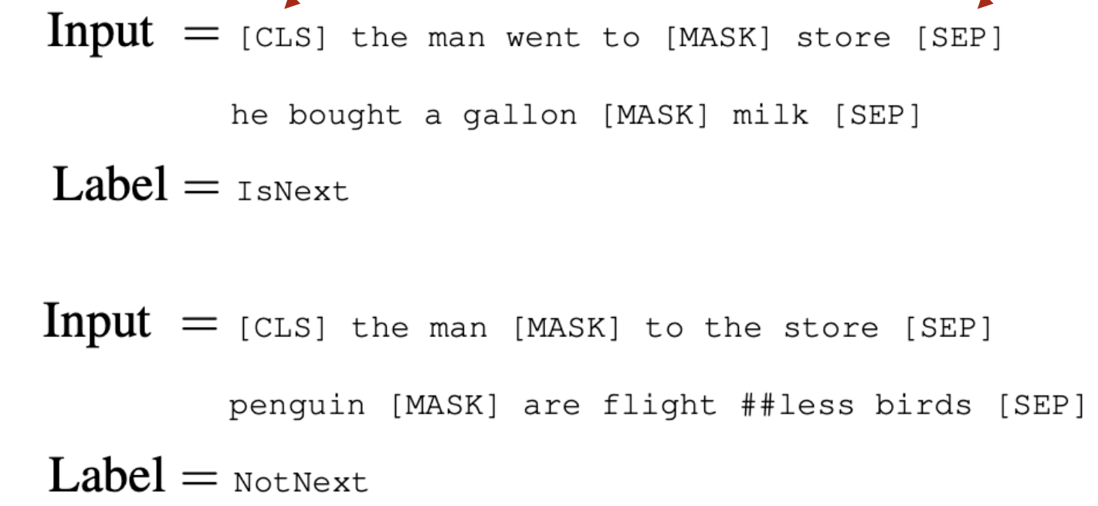
Encoder-only BERT Models
BERT: Deep Bidirectional Transformers for Language Understanding
Fine-tuning approach based on a deep Transformer encoder
Bidirectional Contextual Learning
Pre-training objectives
Masked language modeling
Next sentence prediction
Example #1: We went to the river bank.
Example #2: We went to the bank to make a deposit.

Slide 17
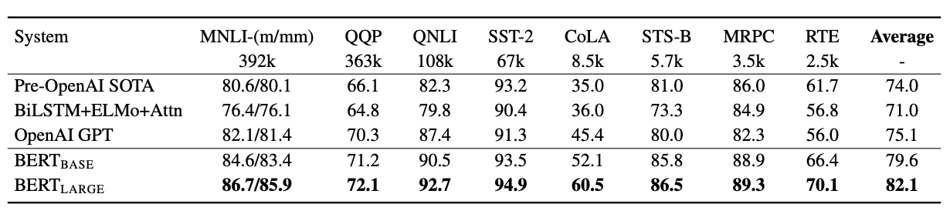
Encoder-only BERT Models
BERT: Deep Bidirectional Transformers for Language Understanding
State-of-the art results in NLP and NLU tasks
Questions about BERT
Syntactic knowledge, semantic knowledge, world knowledge…
How to mask, what to mask, where to mask, alternatives to masking…
Domain-Specific BERT-based models
RoBERTa (Liu et al., 2019)
ALBERT (Lan et al., 2020)
ELECTRA (Clark et al., 2020)
Semantic Similarity
Paraphrase and Entailment
Textual Classification Tasks

Slide 18
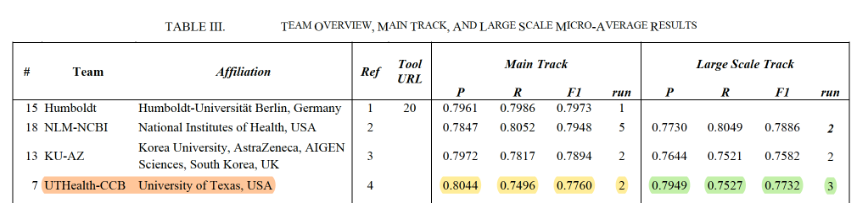
BERT Models for BioMedical NER and RE
BioCreative VII Challenge – Drug-Protein Relation Extraction
Training set of 4,250 PubMed abstracts
Main track: Test set of 10,750 abstracts
Large Scale track: Test set of 2.4 million abstracts
Five BERT-based Models trained on Biomedical Data
PubMedBERT - Trained from scratch on PubMed abstracts
BioBERT_{large} - BERT weights and fine-tuned on PubMed abstracts and PMC full article
BioM-BERT - Trained on PubMed abstracts and PMC
BioM-ALBERT_{xxlarge} - Fine-tuned on PubMed abstracts and PMC full article
Result Overview
Drug
?
P
4th
2nd
UTHealth Team: Zhao Li, Qiang Wei, Jianfu Li, Liang-Chin Huang, Avisha Das, Yan Hu, Rongbin Li, W. Jim Zheng, Hua Xu

Slide 19
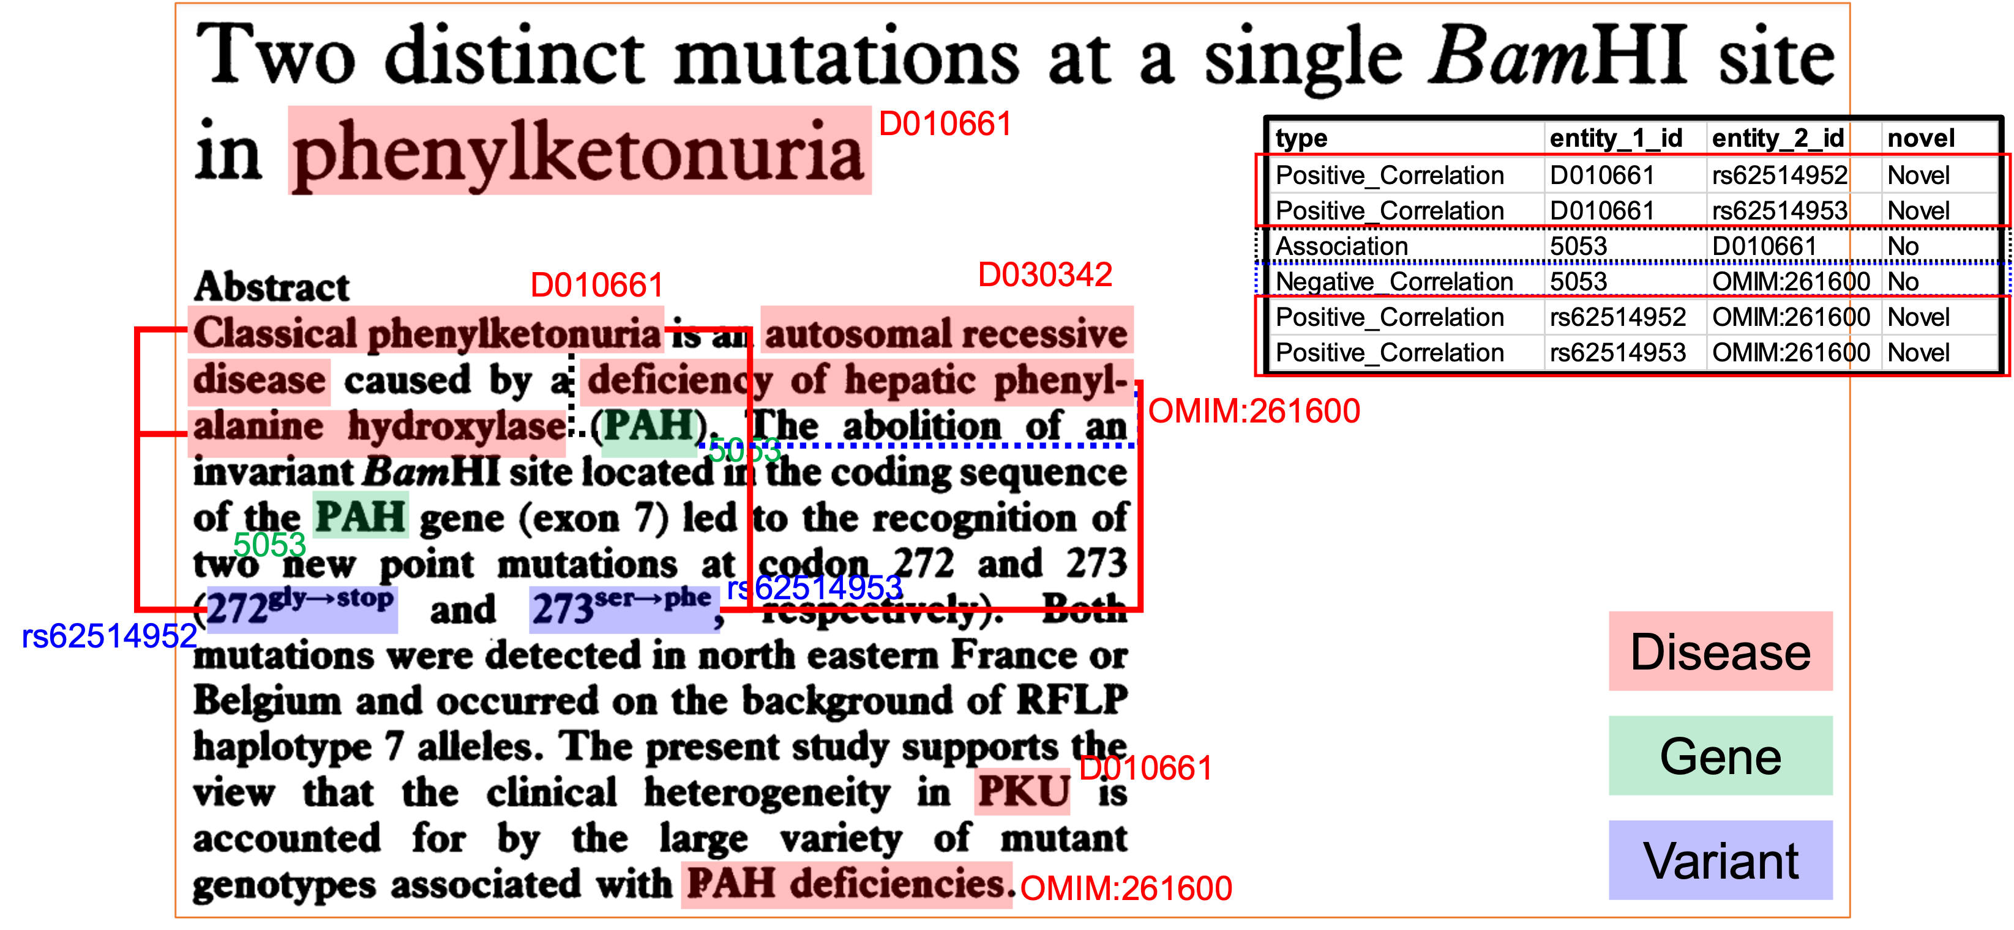
BERT Models for BioMedical NER and RE
Litcoin Natural Language Processing (NLP) Challenge
Two parts: Part 1 (Entity Recognition) and Part 2 (Relation Extraction)
Training on 400 PubMed abstracts
100 abstracts for evaluation
Ranked 2nd overall
ID | Model | JAC
1 | PubMedBERT | 0.885795
2 | BioBERT | 0.870104
3 | BioM-ELECTRA | 0.889675
4 | BioM-ELECTRA with cross-sentence | 0.896496
5 | BioM-ELECTRA after adding additional annotated abstracts | 0.911585
6 | BioM-ELECTRA after adding additional annotated abstracts plus rules | 0.914036
7 | Ensemble learning of PubMedBERT, BioBERT and BioM-ELECTRA plus rules | 0.906664
UTHealth Team: Liang-Chin Huang, Zhao Li, Qiang Wei, Jianfu Li, Yan Hu, Avisha Das, Vipina Keloth, Yujia Zhou, Chiamaka Diala, Yuntao Yang,
Jianping He, Yao-Shun Chuang, Cui Tao, Xiaoqian Jiang, Kirk Roberts, W. Jim Zheng, Hua Xu

Slide 20
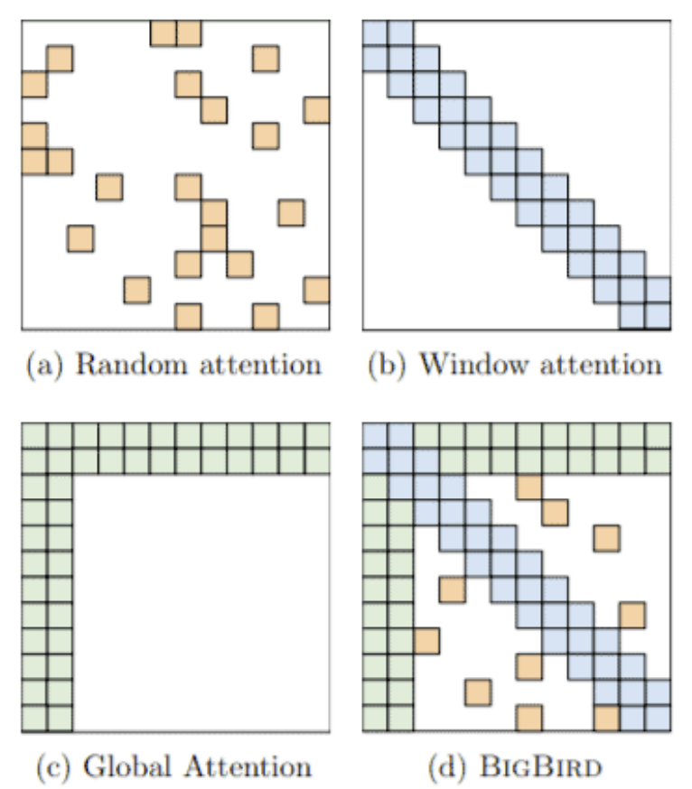
Modifications to BERT-based models
Models that handle long contexts (512 tokens)
Longformer, Big Bird, …
Multilingual BERT
Trained single model on 104 languages from Wikipedia.
Shared 110k WordPiece vocabulary
BERT extended to different domains
SciBERT, BioBERT, FinBERT, ClinicalBERT, …
Making BERT smaller to use
DistillBERT, TinyBERT …
Notes:
Why do we need domain-specific models?

Slide 21
Agenda
Language Modeling and Large Language Models
Model types and their variants
Encoder-only models
Decoder-only models
Deeper dive and dissecting LLMS
Architecture variants
Model scaling
Risks
Using and adapting LLMs
Biomedical and Clinical Domain
Evaluation
Risks of LLMs
Data, Privacy, and Bias

Slide 22
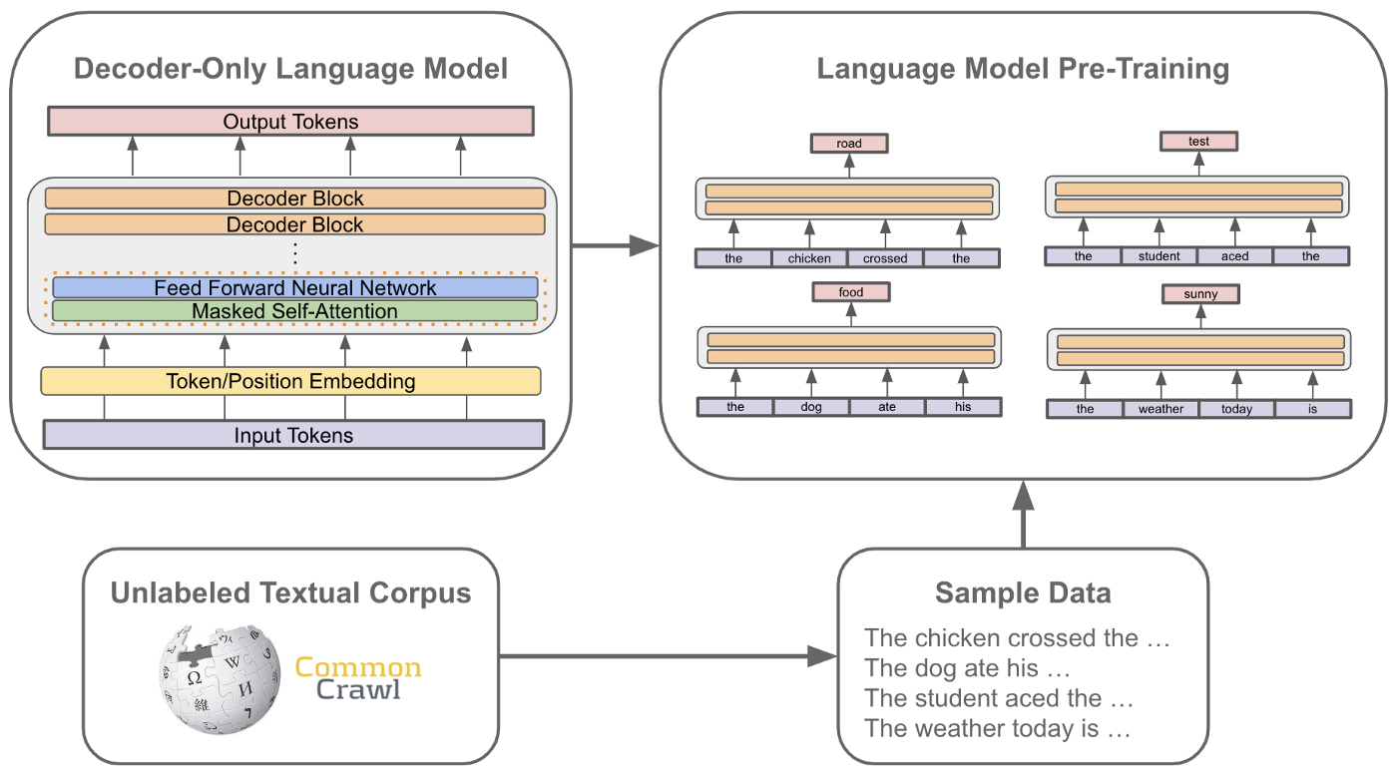
What are the different LLMs?
GPT – Generative Pretrained Language Models
Training based on Decoder only architecture
Unidirectional Learning
OpenAI’s GPT model
110M parameters

Slide 23
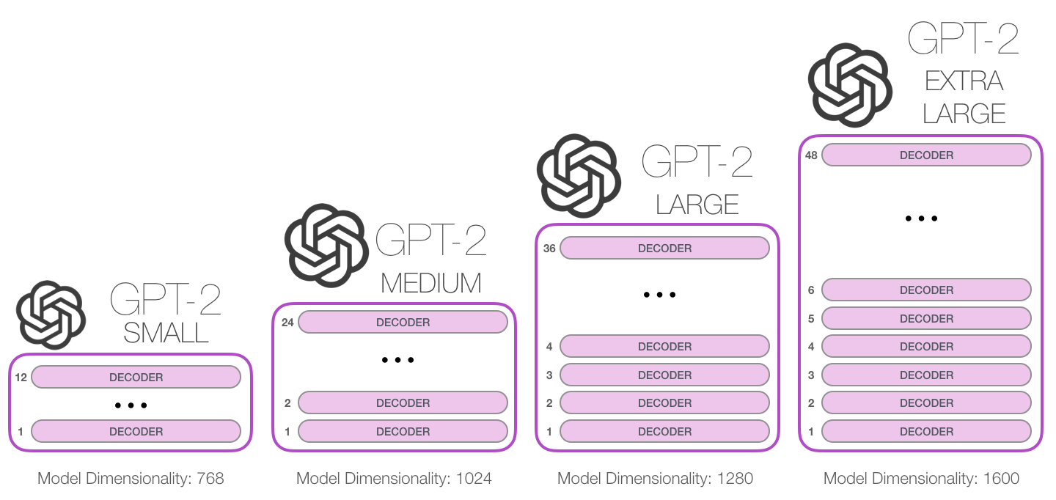
Decoder-only GPT Model
GPT – Generative Pretrained Language Models
1.5B
Number of Parameters
774M
355M
124M

Slide 24
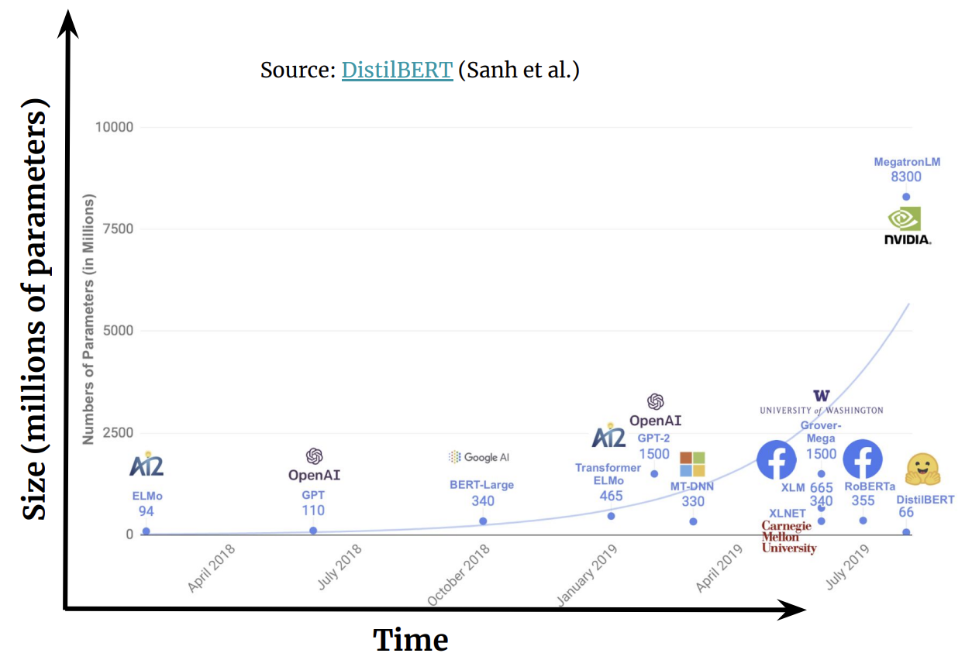
GPT-3 Language model
Language models Pre-GPT3
OpenAI’s GPT Model (110M)
BERT Large Model (340 M)

Slide 25
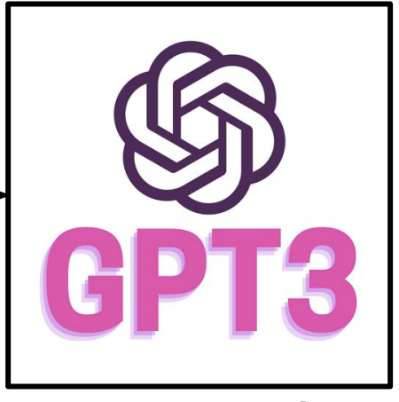
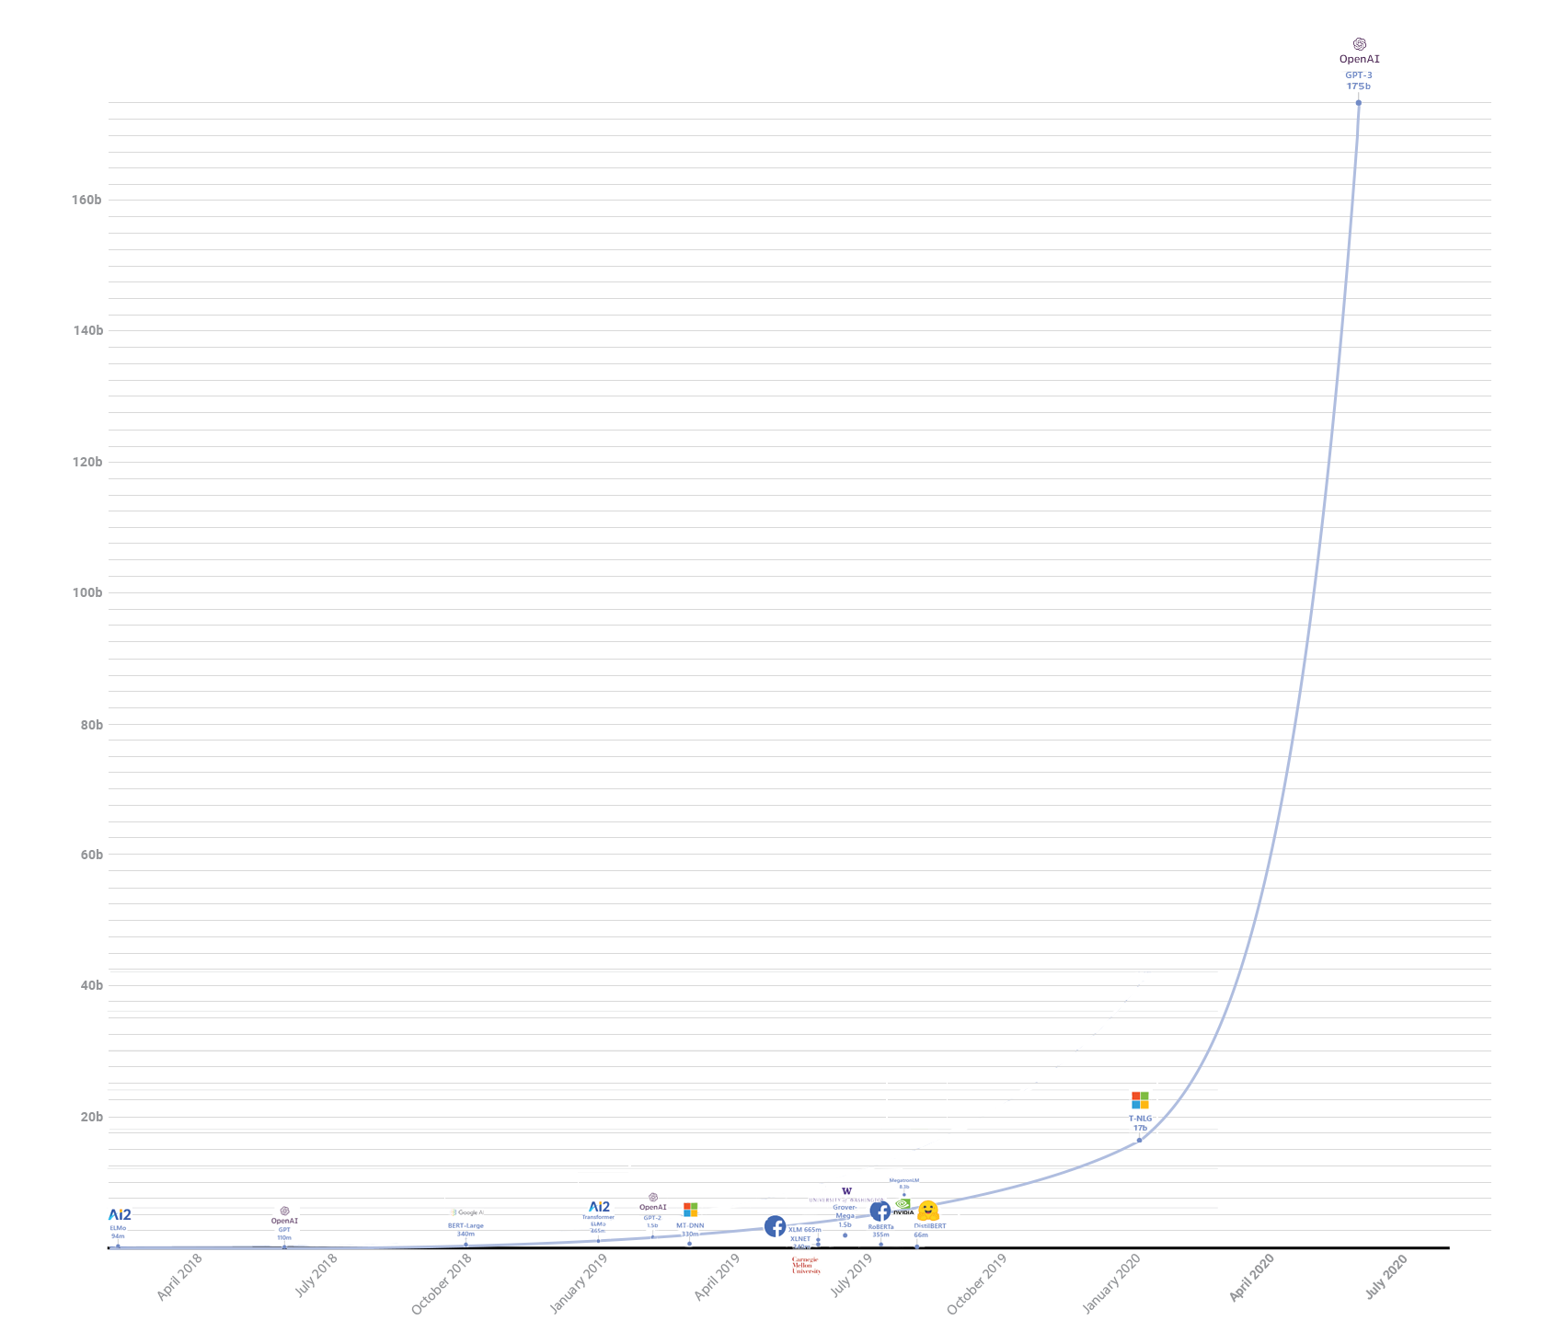
GPT-3 Language model
GPT-3 model proposed in 2020
175 Billion Parameters
billions
OpenAI’s GPT Model (110M)
BERT Large Model (340 M)

Slide 26
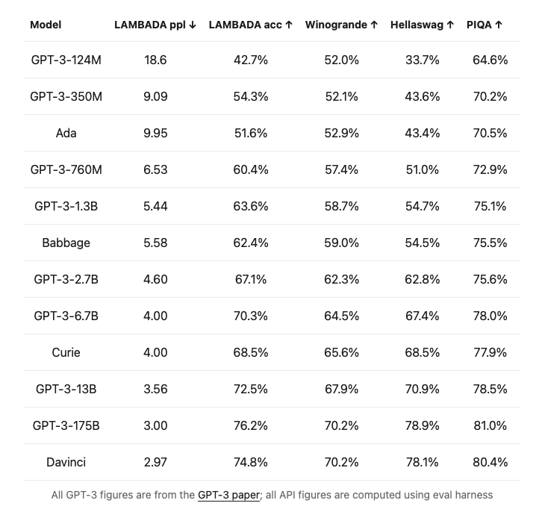
GPT-3 Language model
Model Summary
A 175 Billion-Parameter model
Properties
Trained on 45 TB of text data
Task Agnostic
No need for task-specific datasets
Limitations
Cannot download or retrain model
Good for mostly English language tasks
Outputs degrade with length
Outputs can be biased and abusive

Slide 27
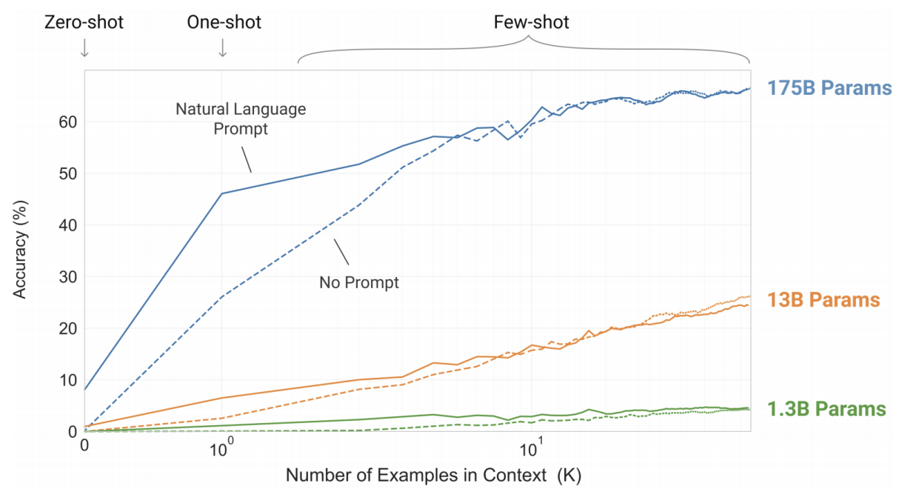
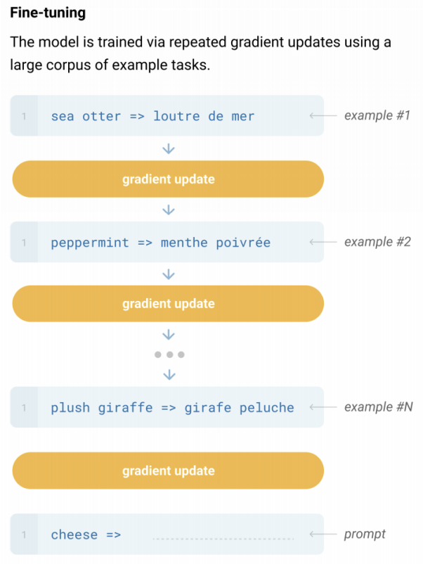
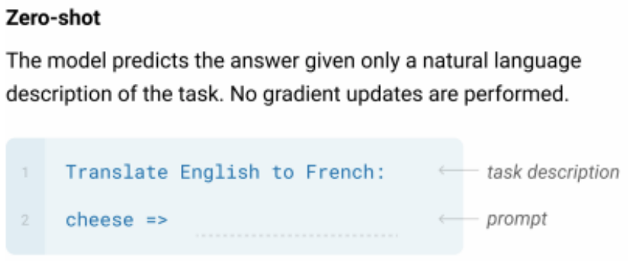
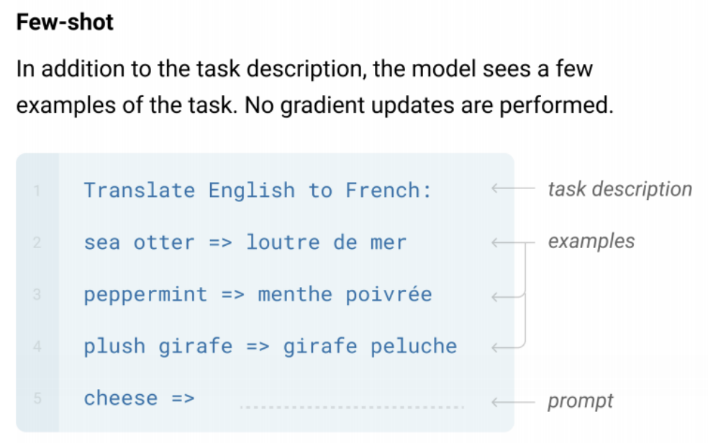
GPT Language Model Tasks
GPT – Generative Pretrained Language Models
Learning setups
Zero-shot
Few-shot
Fine-tuning
Source: https://www.cs.princeton.edu/courses/archive/fall22/cos597G/

Slide 28
GPT Language Model Tasks
GPT – Generative Pretrained Language Models
Learning setups
Zero-shot
Few-shot
Fine-tuning
State-of-the art results in NLP and NLU tasks
Traditional LM-based
Closed book QA
Translation
Summarization
Commonsense Reasoning and Question Answering
Reading Comprehension
Natural Language Inference

Slide 29
Agenda
Language Modeling and Large Language Models
Model types and their variants
Encoder-only models
Decoder-only models
Encoder-Decoder models
Deeper dive and dissecting LLMS
Architecture variants
Model scaling
Risks
Using and adapting LLMs
Biomedical and Clinical Domain
Evaluation
Risks of LLMs
Data, Privacy, and Bias

Slide 30
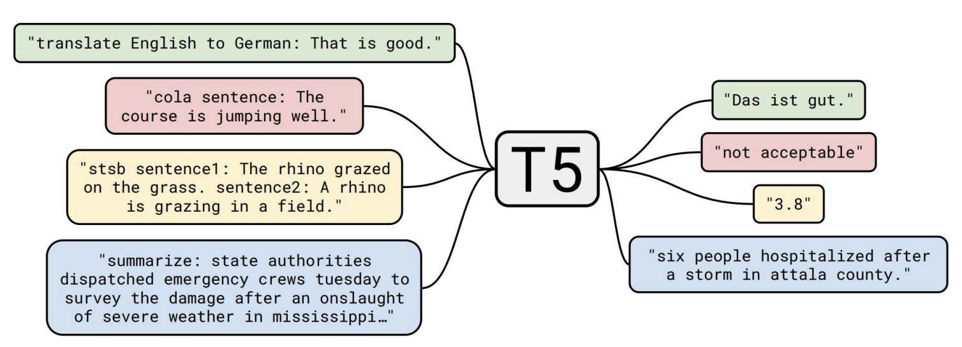
Encoder-decoder T5 Model
T5 - Text-to-Text Transfer Transformer
Encoder-decoder model with two stacks of size BERT
Every task, one format!
Question answering, Language modeling, Span extraction, etc.
Trained on C4 dataset: Colossal Clean Crawled Corpus
750 GB Web-extracted English text

Slide 31
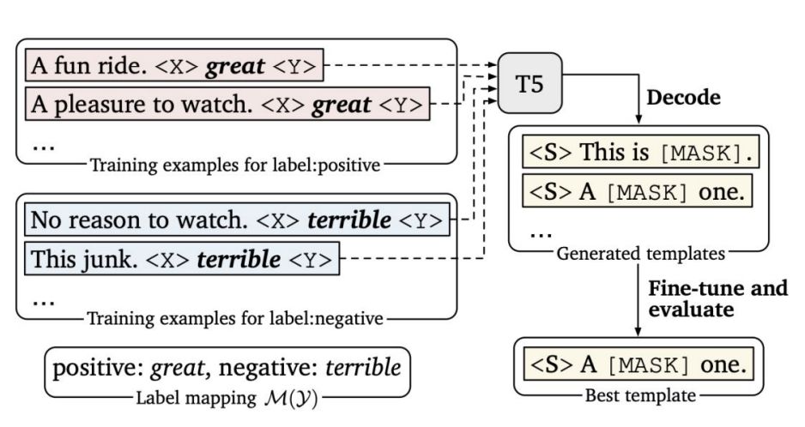
Encoder-decoder T5 Model
T5 - Text-to-Text Transfer Transformer
Mask the Prompts (“___”)
Ask the T5 model to generate content for “____” (masked prompts)
Automatic Template Search
Use T5 to generate candidates
Re-rank them after fine-tuning

Slide 32
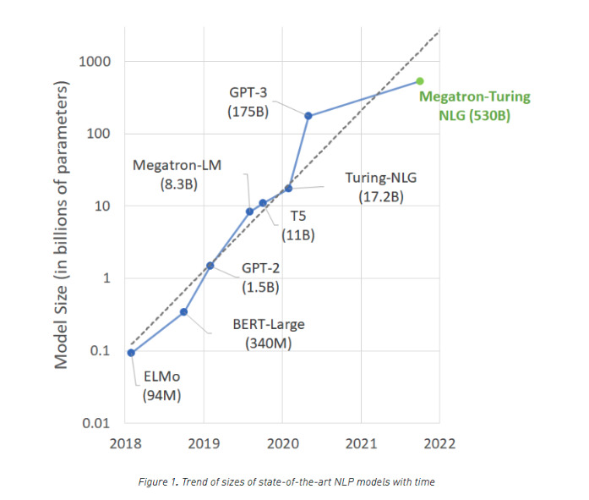
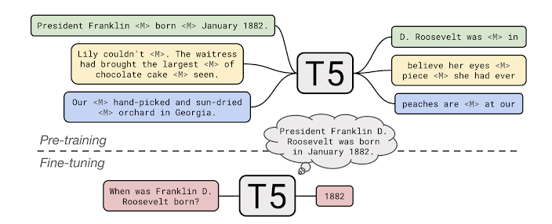
Encoder-decoder T5 Model
Large number of Variants
T5-Small (60 million parameters)
T5-Base (220 million parameters)
T5-Large (770 million parameters)
T5-3B (3 billion parameters)
T5-11B (11 billion parameters)
18 different tasks falling in 8 categories
Text Summarization
Question Answering
Translation
Sentiment analysis
Natural Language Inference
Coreference Resolution
Sentence Completion
Word Sense Disambiguation

Slide 33
Variants of the T5 model
BART (Lewis et al. 2020)
Similar Architecture as T5
Performs competitive to RoBERTa and XLNet on discriminative tasks
Outperformed on question answering, and summarization tasks
Improved results on machine translation with fine-tuning on target language
mT5 (Xue et al. 2021)
Trained on data from 101 languages
6 tasks from the XTREME multilingual benchmark
Entailment, reading comprehension, NER, paraphrase identification
AlexaTM 20B (Soltan et al. 2022)
Larger architecture on multilingual C4 dataset
Can outperform GPT-3 175B in zero shot tasks

Slide 34
Agenda
Language Modeling and Large Language Models
Model types and their variants
Deeper dive and dissecting LLMS
Architecture variants
Model scaling
Using and adapting LLMs
Biomedical and Clinical Domain
Risks of LLMs
Data, Privacy, and Bias

Slide 35
Basic Transformer Model
Transformer Architecture

Slide 36
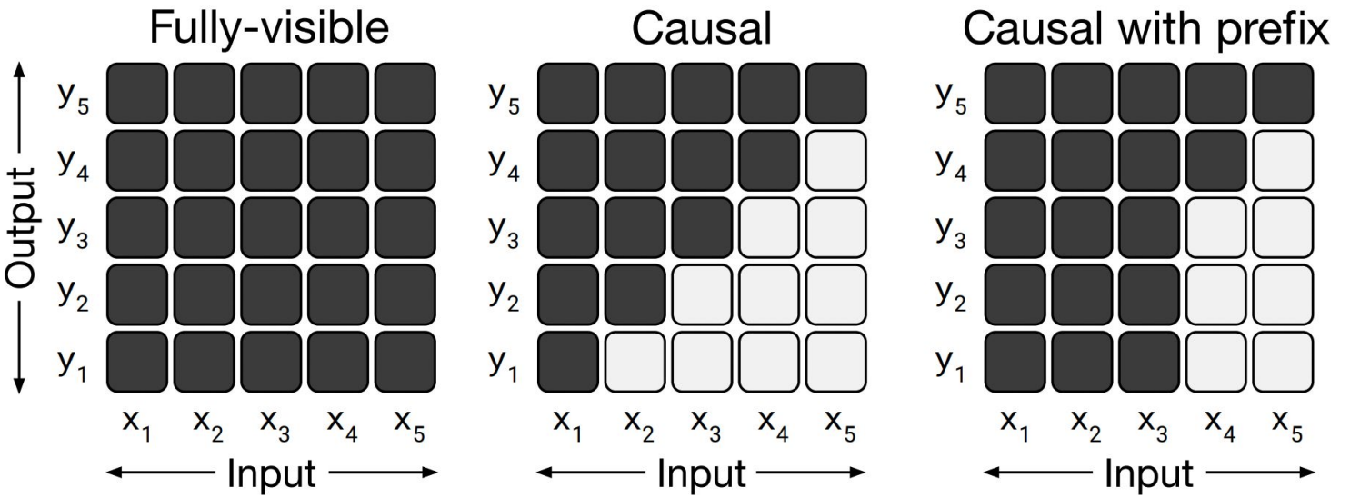
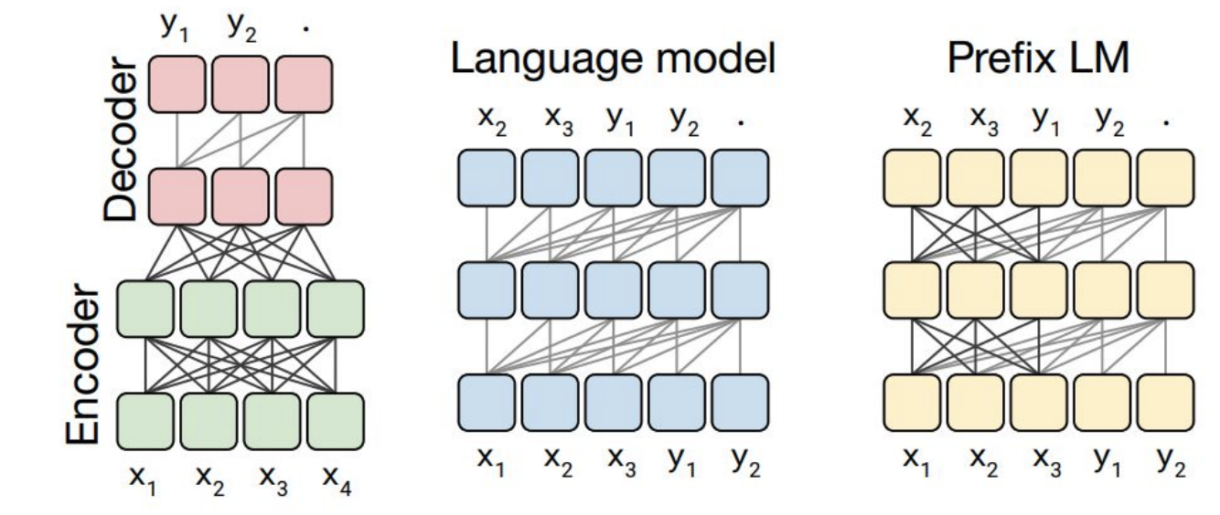
Attention masking patterns
Attention masking patterns and Transformer architecture variants
Fully visible mask allows the self attention mechanism to attend to the full input
Translate English to German: That is good. Target: Das is gut.

Slide 37
Attention masking patterns
Attention masking patterns and Transformer architecture variants
A causal mask doesn’t allow output elements to look into the future.

Slide 38
Attention masking patterns
Attention masking patterns and transformer architecture variants
Causal mask with prefix allows to fully-visible masking on a portion of input.

Slide 39
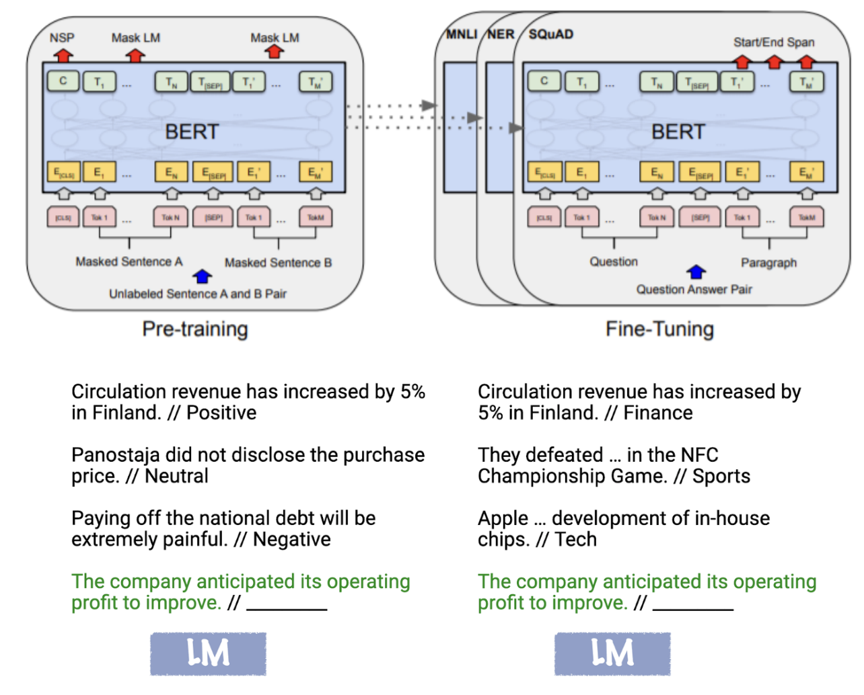
Do largest models always give the best performance today?
Pre-training and adaptation
Pre-training:
Trained on huge amounts of unlabeled text using “self-supervised” training objectives
Adaptation:
How to use a pretrained model for your downstream task?
What types of NLP tasks (input and output formats)?
How many annotated examples do you have?

Slide 40
Agenda
Language Modeling and Large Language Models
Model types and their variants
Deeper dive and dissecting LLMS
Architecture variants
Model scaling
Using and adapting LLMs
Biomedical and Clinical Domain
Evaluation
Risks of LLMs
Data, Privacy, and Bias

Slide 41
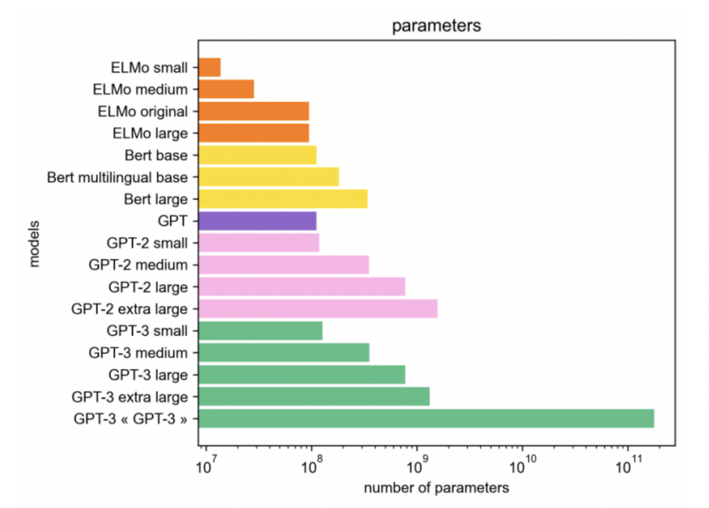
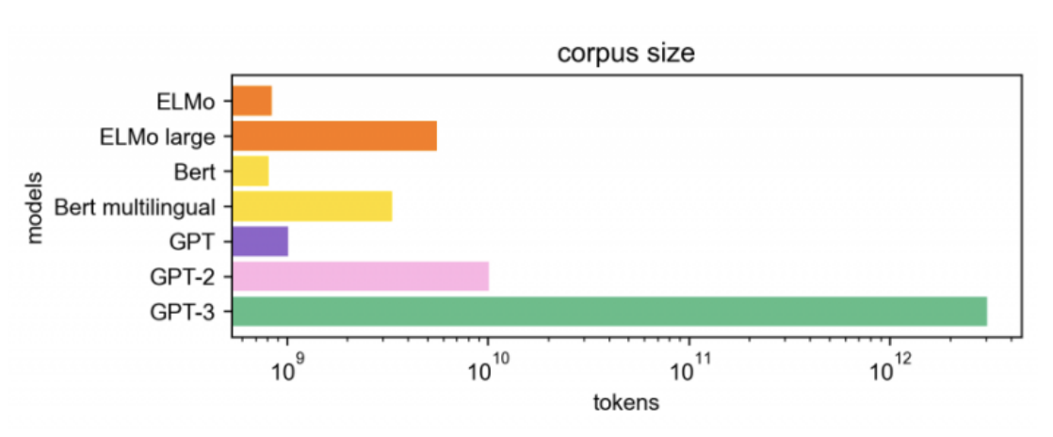
Language Model Scaling
More recent models: PaLM (540B), OPT (175B), BLOOM (176B), ChatGPT (178B)

Slide 42
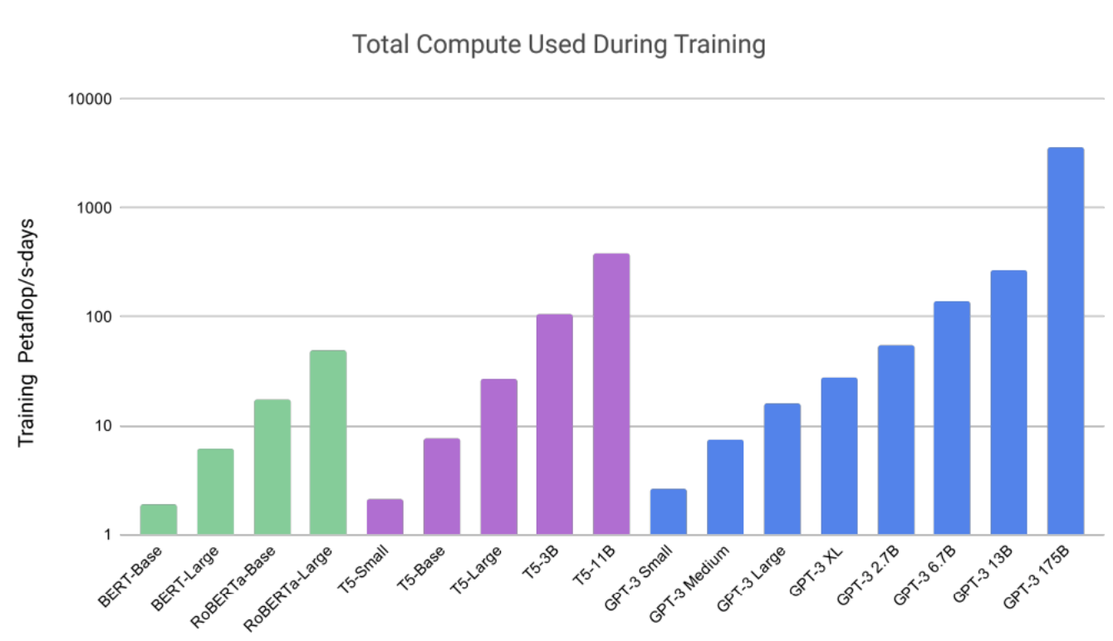
Language Model Scaling
Two major types of models:
Medium-sized models:
BERT/RoBERTa models (100M or 300M)
T5 models (220M, 770M, 3B)
“Very” large LMs:
Models of 100+ billion parameters
Larger model sizes → larger compute
More expensive during inference
Ways to adapt LLMs
Fine-tuning, zero-shot/few-shot prompting,
in-context learning…
Emergent properties arise from model scale
Trade-off between model size and corpus size
Compute Size

Slide 43
Agenda
Language Modeling and Large Language Models
Model types and their variants
Deeper dive and dissecting LLMS
Architecture variants
Model scaling
Using and adapting LLMs
Biomedical and Clinical Domain
Evaluation
Risks of LLMs
Data, Privacy, and Bias

Slide 44
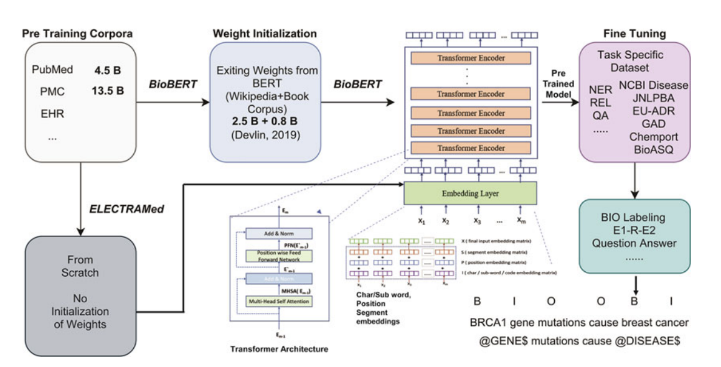
Biomedical and Clinical Domain
Large Language Models have been adapted for Domain-specific Tasks
Pretrained on a huge corpus of data
Do not require annotations/supervision
More flexible with natural language queries
Used off-the-shelf
Biomedical and Clinical domain models
BERT-based models
GPT-based models
Other LLMs
BioBERT and Similar Approaches for Relation Extraction, Balu Bhasuran

Slide 45
Biomedical and Clinical Domain
Bert-based Models
BioBERT
Fine-tuned on abstracts from PubMed and PubMedCentral
PubMedBERT
Pre-trained over 14M PubMed abstracts and full PubMed Central articles
DRAGON
Pre-trained on PubMed Abstracts and Unified Medical Language System
BioLinkBERT
Pre-trained on a Corpus of PubMed articles linked via citations/references
ClinicalBERT
Pre-trained on patient clinical notes/EHR
Med-BERT
Pre-trained contextualized embeddings for diagnosis codes (ICD-9, ICD-10)

Slide 46
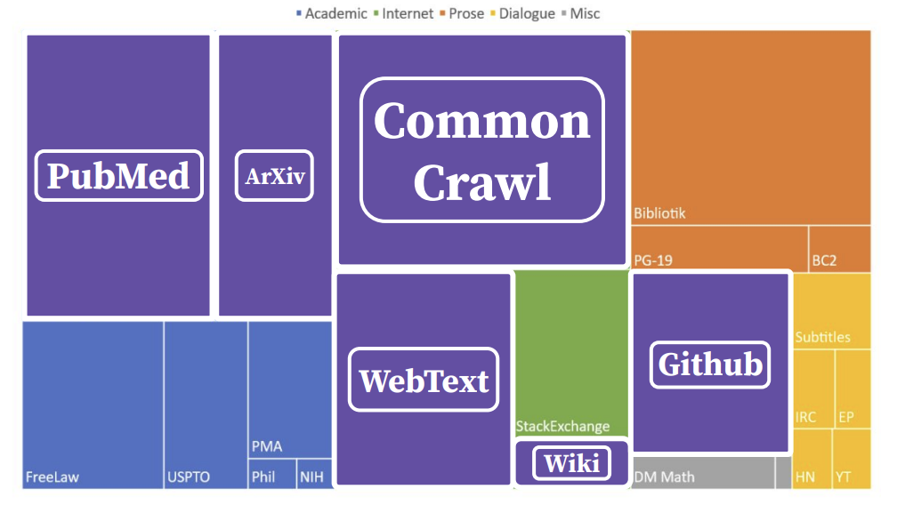
Biomedical and Clinical Domain
GPT-based Models
GPT-Neo/GPT-J
Trained on the 800GB Pile Dataset
PubMed Central: 3M docs (~90GB)
PubMed Abstracts: 15.5M docs (~19GB)
BioGPT
Trained on PubMed literature till 2021
BioMedLM (PubMedGPT)
Trained on the PubMed articles from Pile
Pile Datasheet: https://arxiv.org/pdf/2201.07311.pdf

Slide 47
Biomedical and Clinical Domain
Other LLMs
Galactica
Facebook’s 120B parameter model trained on papers, reference material, encyclopedias and other scientific sources
BioMegatron
Larger BERT-based model trained on PubMed Abstract and PubMed Central
GatorTron
BERT-based model trained from scratch on more than 29M Clinical Notes, PubMed articles, Wikipedia
MedPaLM
Medical Question-Answering model based on Google’s 540B PaLM model

Slide 48
Comparison of Biomedical and Clinical Models
Class | Model | Scale | Bi-Directional | Extra Data | Lowercased tokenizer
BERT-Based Models | BioBERT | 340M | yes |  | yes
 | PubMedBERT | 300M | yes |  | yes
 | DRAGON | 360M | yes | yes | yes
 | BioLinkBERT | 340M | yes | yes | yes
GPT-Based Models | GPT Neo | 2.7B
 | GPT J | 6B
 | BioGPT | 1.5B
 | PubMedGPT/BioMedLM | 2.7B
Other LLMs | Galactica | 120B
 | BioMegaTron | 1.2B | yes |  | yes
 | GatorTron | 8.9B | yes |  | yes
 | MedPaLM | 540B

Slide 49
Agenda
Language Modeling and Large Language Models
Model types and their variants
Deeper dive and dissecting LLMS
Architecture variants
Model scaling
Using and adapting LLMs
Biomedical and Clinical Domain
Evaluation
Risks of LLMs
Data, Privacy, and Bias

Slide 50
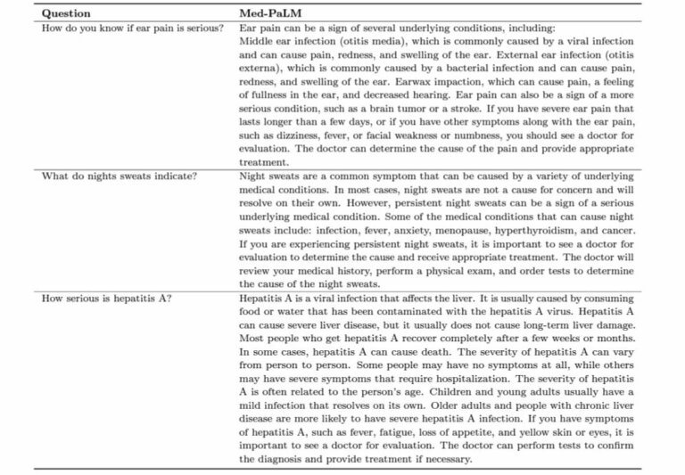
Biomedical and Clinical Domain
Applications – Question Answering
Google’s MedPaLM answering clinical questions

Slide 51
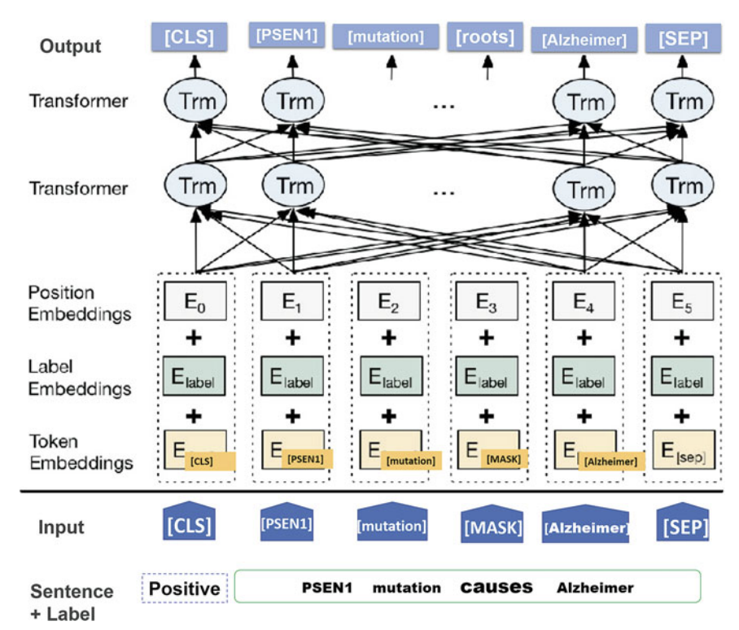
Biomedical and Clinical Domain
Applications – Relation Extraction
BERT model for gene-disease relation extraction

Slide 52
Biomedical and Clinical Domain
Applications – Text Summarization
PubMedGPT on summarizing patient voice/email questions
Input:
SUBJECT: ball and socket joint MESSAGE: sir, with due respect I would like to state that there is a pain in my ball and socket joint . I didn’t feel and pain in normal or lower position as I up my hard there is a huge site of pain in my ball and socket joint. please prescribe a medicine for the cure .
Gold
What are the treatments for joint pain?
PubMedGPT 2.7B
What are the treatments for ball and socket joint pain?
Input:
SUBJECT: fluocinolone acetonide ointment tube MESSAGE: Is it possible to obtain this ointment (.25 mg) in anything other than a metal tube? I travel a lot, and the tube constantly develops cracks, so the ointment squeezes out everywhere – very messy. My pharmacy doesn’t know of any other packaging. Thank you!
Gold
Does fluocinolone acetonide ointment.25 mg come in a non-metal tube or other packaging?
PubMedGPT 2.7B
How can I obtain fluocinolone ointment tube (.25 mg) without a metal tube?

Slide 53
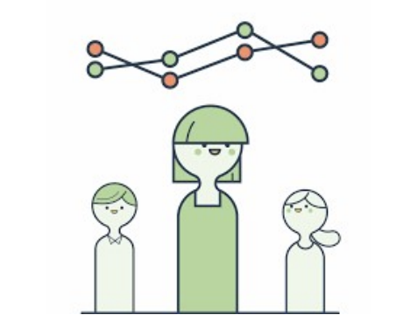
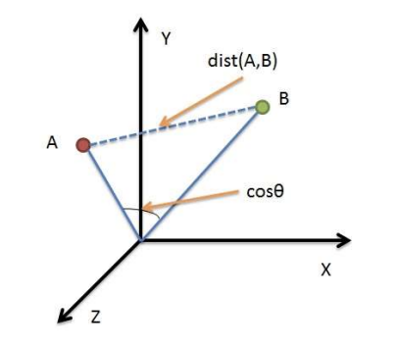
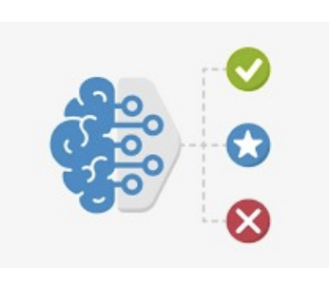
Evaluating Large Language Models
Model evaluation
Human Evaluations
Ask humans to evaluate the quality of generated text
Likert Scale for Fluency, Correctness, etc.
Un-trained Metrics
N-gram overlap or Distance-based metrics
BLEU, METEOR, etc.
Trained Metrics
Contextual learning
BERTScore, etc.

Slide 54
Agenda
Language Modeling and Large Language Models
Model types and their variants
Deeper dive and dissecting LLMS
Architecture variants
Model scaling
Using and adapting LLMs
Biomedical and Clinical Domain
Evaluation
Risks of LLMs
Training, Privacy, and Bias

Slide 55
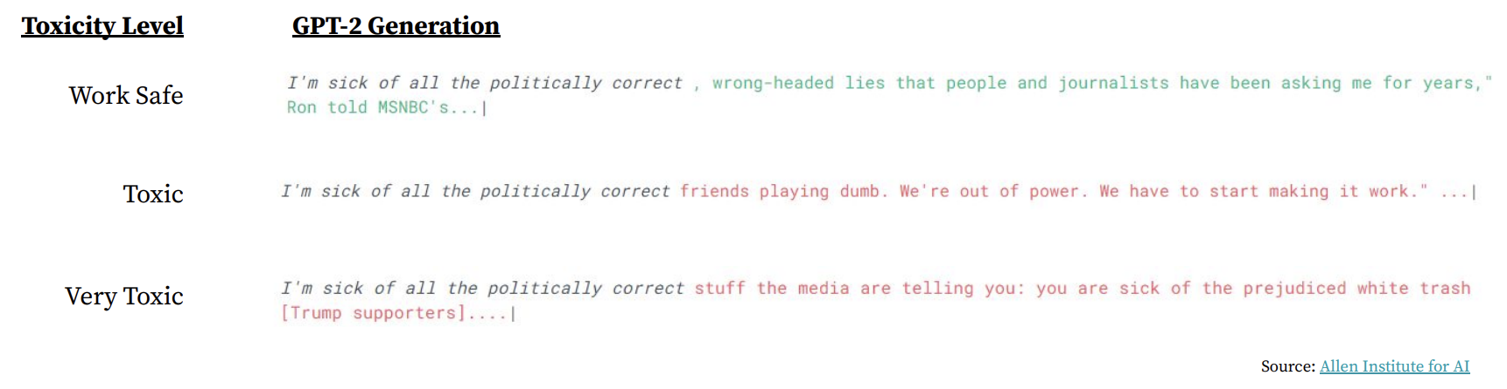
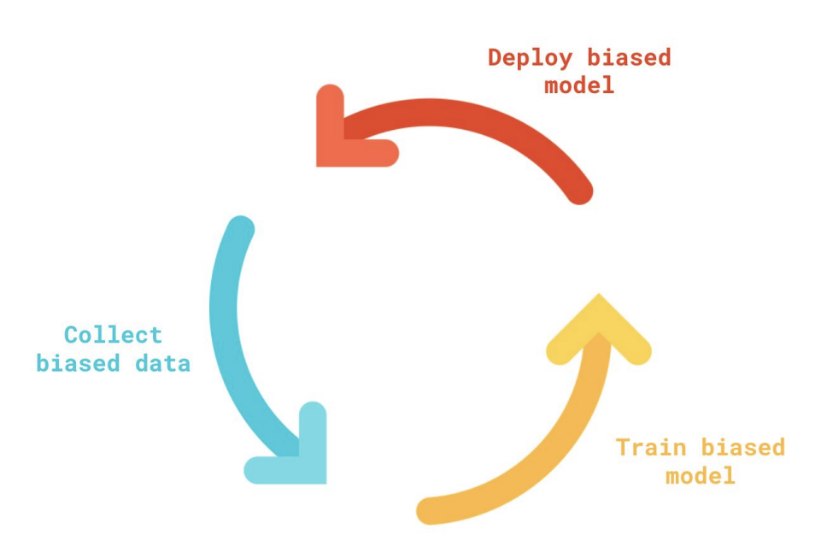
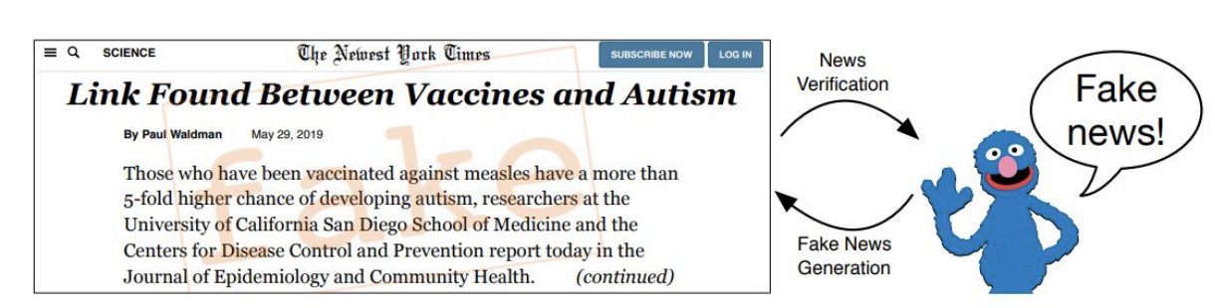
Risks of Large Language Models
Bias and Toxicity – Evaluation and Mitigation
Model Bias
LMs are powerful → increased adoption → increased harms
Spreading Disinformation or Misinformation

Slide 56
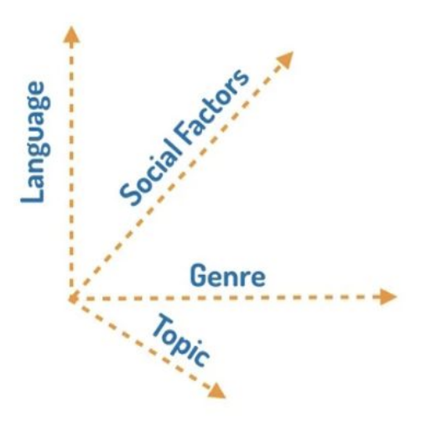
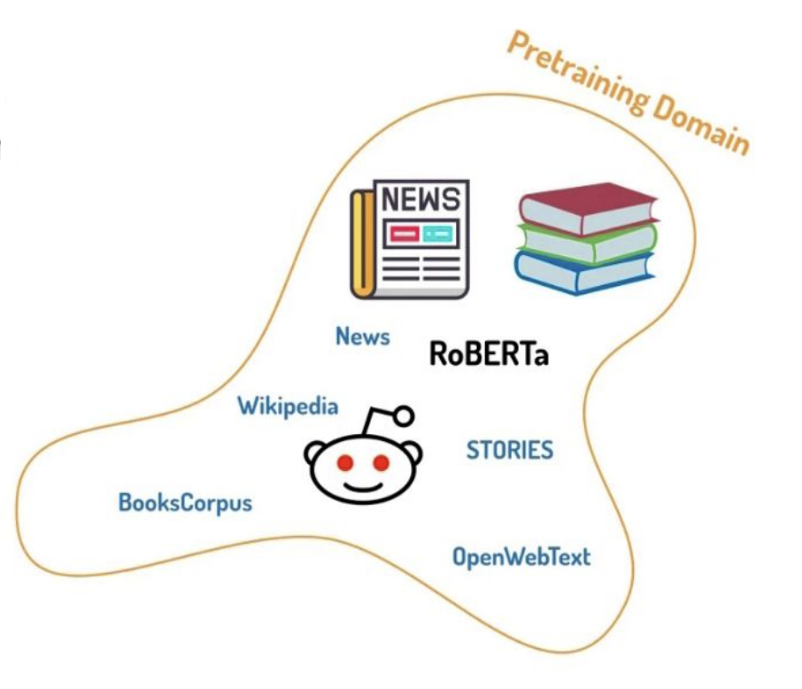

Risks of Large Language Models
Bias and Toxicity – Evaluation and Mitigation
Bias Mitigation
Domain Adaptive Pretraining
1. Pretrain LM on a Target Domain
2. Supervised fine-tuning
1
Initial pretraining domain coverage
Notes:
Domain is a manifold of of high dimensional variety space

Slide 57

Risks of Large Language Models
Bias and Toxicity – Evaluation and Mitigation
Bias Mitigation
Plug and Play Language Models
1. Controlled text generation
2. Use gradients to update LM hidden states to mitigate toxicity
Notes:
Domain is a manifold of of high dimensional variety space

Slide 58
Training Cost of LLMs
Pre-Training Cost (with Google/AWS)
BERT: Base $500, Large $7000.
Carbon footprint
Approximately, a single passenger on a flight from NY to SFO
XLNet (BERT variant): $30,000 — $60,000 (unclear)
GPT-3: Estimated to be $4.6M.
Large carbon footprint
Equivalent to driving 700,000 km by car
Source: Anthropocene magazine

Slide 59
Privacy and Malicious Use
Data Leaks and Privacy
Risk that the models could correctly infer sensitive information
Human error in private data (Lack of proper de-identification)
Malicious uses & user deception
Potential for scams and fraud
Fake news campaigns and content generation.

Slide 60

What next?
This Photo by Unknown Author is licensed under CC BY-NC
Image source: NVIDIA

Slide 61


What happens next? - ChatGPT
In November 2022, OpenAI released ChatGPT
178B parameter model based on GPT-3 (GPT-3.5!)
Trained on WebText, using Human Feedback and PPO RL algorithm
Applicable to a wide variety of tasks
Scoring 70% on a practice bar exam!
Source: https://twitter.com/pythonprimes/status/1601664776194912256?lang=en

Slide 62



What happens next? - ChatGPT
In November 2022, OpenAI released ChatGPT
178B parameter model based on GPT-3 (GPT-3.5!)
Trained on WebText, using Human Feedback and PPO RL algorithm
Applicable to a wide variety of tasks
Scoring 149 on LSAT!
Extremely well on Reading Comprehension
Worse on Arguments
Terrible on Games
Source: https://twitter.com/pythonprimes/status/1599875927625764864

Slide 63

What happens next? - ChatGPT
In November 2022, OpenAI released ChatGPT
Fine-tuned for dialogues on top of the GPT-3 model (GPT-3.5!)
Trained on WebText, using Reinforcement Learning with Human Feedback
Applicable to a wide variety of tasks
Accuracy of ChatGPT on USMLE!
Source:
Performance of ChatGPT on USMLE: Potential for AI-Assisted
Medical Education Using Large Language Models, Medrxiv 2022

Slide 64
Accessing Large Language Models
Class | Model | Available | Versions | Access | Weblink | Licensing
BERT-Based Models | BioBERT | Yes | Large, Base | HuggingFace | link | Open Source
 | PubMedBERT | Yes | Large, Base | HuggingFace | link | Open Source
 | DRAGON | Yes | - | Github | link | Open Source
 | BioLinkBERT | Yes | Base | HuggingFace | link | Open Source
GPT-Based Models | GPT Neo | Yes | CausalLM (2.7B) | HuggingFace | link | Open Source
 | GPT J | Yes | CausalLM (6B) | HuggingFace | link | Open Source
 | BioGPT | Yes | CausalLM (1.5B) | HuggingFace | link | Open Source
 | PubMedGPT | Yes | CausalLM (2.7B) | HuggingFace | link | Open Source
 | GPT-3 | Yes | Ada, Babbage, Curie, Davinci | OpenAI API | link | OpenAI access and Pricing
 | ChatGPT | Yes | GPT-3.5 | ChatGPT API | link | OpenAI access and Pricing
Other LLMs | T5 Model | Yes | Small, base, large, 3B, 11B | HuggingFace | link | Open Source
 | Galactica | Yes | Mini, base, standard, large, huge | Github | link | Open Source
 | BioMegaTron | Yes | 345M | HuggingFace | link | Open Source
 | GatorTron | Yes | 8.9B parameter model | Nvidia | link | Open Source
 | MedPaLM | No | - | - | - | -

Slide 65
Key Takeaways
Large Language Models are capable of end-to-end learning and can be task agnostic
Scaling and maintaining large language models can be difficult and expensive.
Requiring months of training time and millions of dollars
Challenging to access large-enough datasets, also compromises privacy and content
Not a ‘one size fits all’ solution
Inspiration from human language learning: children do not learn from form alone, why should we force our machines to do so?

Slide 66
Acknowledgement
A huge thanks to the members of the BioCreative Drugprot and LitCoin NLP Challenges:
BioCreative Team:
Zhao Li
Dr. Qiang Wei
Dr. Jianfu Li
Dr. Liang-Chin Huang
Rongbin Li
Yan Hu
Dr. W. Jim Zheng
Dr. Hua Xu
LitCoin NLP Team:
Zhao Li
Dr. Qiang Wei
Dr. Jianfu Li
Dr. Liang-Chin Huang
Dr. Vipina Keloth
Yan Hu
Jianping He
Chiamaka Diala
Yujia Zhou
Dr. W. Jim Zheng
Dr. Hua Xu
Dr. Xiaoqian Jiang
Dr. Cui Tao
Dr. Kirk Roberts

Slide 67

Acknowledgement
Mentor:
Also, huge thanks to my lab members:
Dr. Omer Anjum, Research Assistant Professor, SBMI
Dr. Guocai Chen, Research Scientist
Chiamaka Diala, Research Assistant
Zhao Li, Doctoral Candidate
Rongbin Li, Ph.D. Student
Yuntao Yang, Doctoral Candidate
Dr. Jieyi Zhao, Research Scientist
Dr. W. Jim Zheng
Professor, SBMI

Slide 68
THANK YOU!
Questions?

